Slide 1

Predicting Swiss Super League Stadiums Attendance
Business Analytics und Data Science Applications Capstone Project (Group 11) – HS24
Victor Thijs
Tobias Blankenagel
Clément Durix
Vincent Neuhaus
Notes:
So our project is focused on determining the attendance for all football games in the current Swiss Super league Stadiums

Slide 2



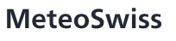

Project overview and data structure
1. Overview
Use case, dataset and methodology
Business case
Data sources
Analysed Models
Staff Planning
1
Linear Regression
Improved accuracy in predicting the number of ushers, cleaners, and medical personnel needed, reducing labor costs without compromising service quality
Real-time adjustments to staff allocation based on live attendance predictions to handle unexpected surges efficiently.
2
Random Forest
Crowd Management
Better crowd control panning to ensure safe and efficient entry and exit flows, reducing bottlenecks and enhancing fan experience
Predictive identification of potential congestion areas, allowing for proactive resource deployment and risk mitigation
3
XG Boost
Sponsorship & Marketing Agencies
Initial Dataset
Advertisers would be interested in accurate attendance forecasts to target the right games according to their budget.
Stadium Attendance
Home Team
Date
Matchday
Weather
Away team
Competition
Time
Temperature
Notes:
Just speak quickly about:
Our target customers would be:
Sports Clubs & Stadium Operators: can use the model to predict attendance for planning for the right staffing levels, security measures, but also add pricing. So globally to efficiently optimize costs and revenues.
Local Transport Authorities: cities can use attendance predictions to prepare public transport and tailor the security between for example the train station and the stadium as it’s often done.
Sponsorship & Marketing Agencies: Advertisers would be interested in accurate attendance forecasts to target the right games according to their budget.

Slide 3








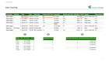
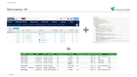
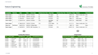
Data pre-processing and Data Cleaning
2. Data Preparation
Introduction
01 | Web Scraping & API
Extraction of Features from Transfermarkt (Home & Away Team, Stadium Attendance etc.)
Extraction of Features from Open Meteo (Weather, Temperature)
Research Web Sources
Extract Data from Web Sources
02 | Data Cleaning
Transformation and Categorization of selected Features
Handling missing values
Handling Missing / False Data
Clean Dataset
Data Transformation
03 | Feature Engineering
Creating and Including new Features to explain Attendance (Derby, Home & Opposing Team Ranking etc.)
Categorizing Features (Ranking, Weather, Time etc.)
Creating New features
Final Dataset
Categorization
Final Dataset
Notes:
Unfortunately, there were no available CSV datasets regarding football results so we decided to Webscrape the data from transfermarkt and extract from the URLs the extended report for Servette FC for the last six seasons all competitions included. So after this webscraping we gathered 10 features the main ones being date, match day, home team and away team, time of the game, ranking of the home team and away team, and attendance.
We also assumed that the weather conditions could be seriously correlated with attendance. So we decided to scrape the weather hourly corresponding exactly to the start time of every match. And for this we found a free API called "Open Meteo”. So we extracted from this API both the Temperature and the Weather as a categorical feature
Data Cleaning
Then ofc we had to clean the data which was time consuming as the Webscraping handed in a very messy dataset for example with the result
Feature Engineering
And finally we decided to add some additional features that we believed could be strongly correlated to Attendance, so we added 14 additional features such as derby as a Boolean, Goals scored in the last five games, number of wins in the last five games, and did some feature engineering by creating categorical columns such as home and away team ranking as you can see at the bottom right.

Slide 4
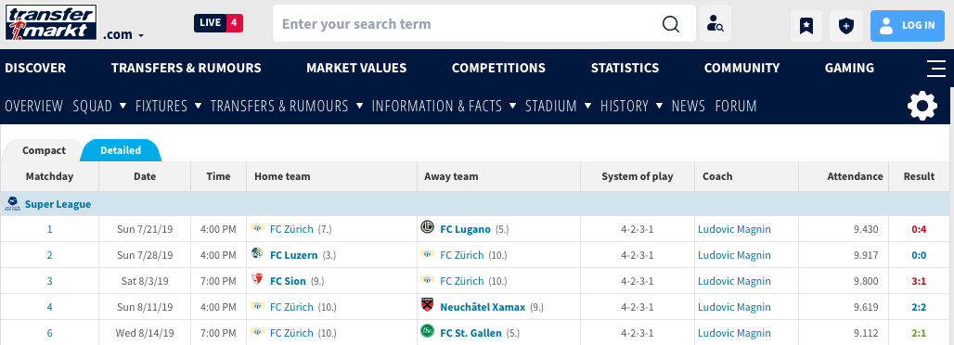
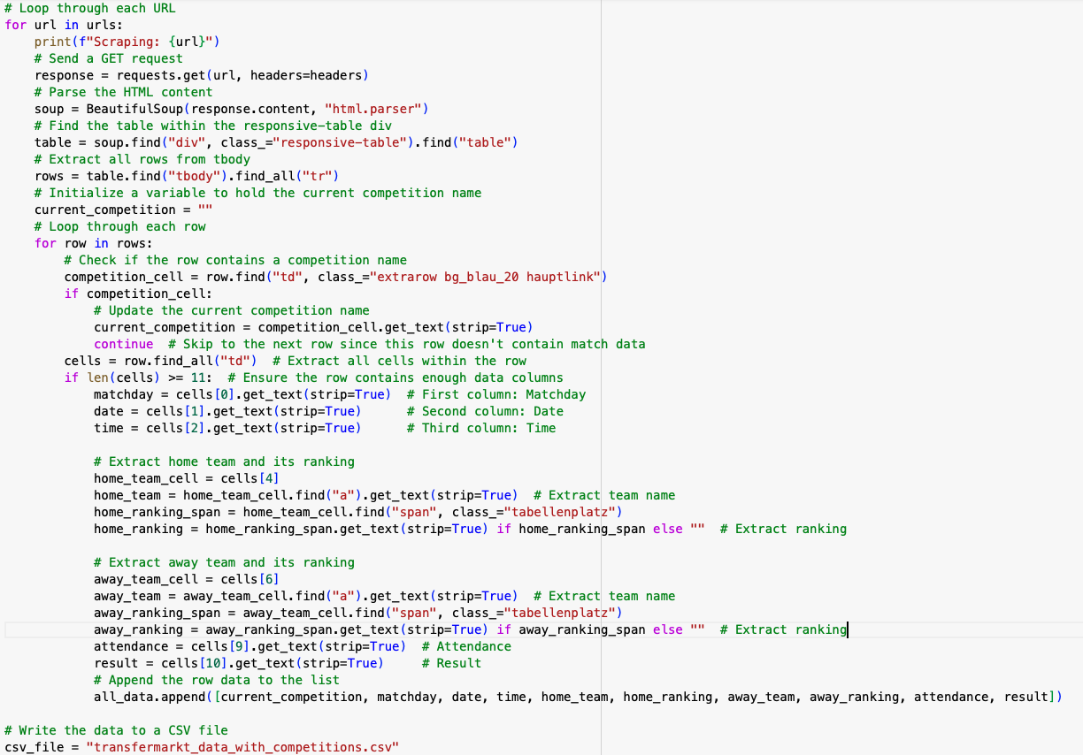
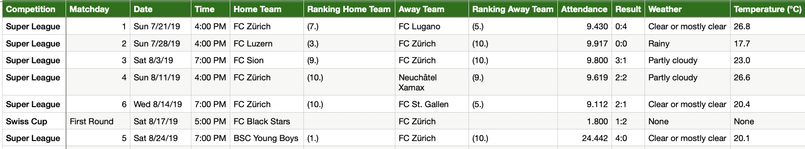
Web Scraping + API
2. Data Preparation

Slide 5
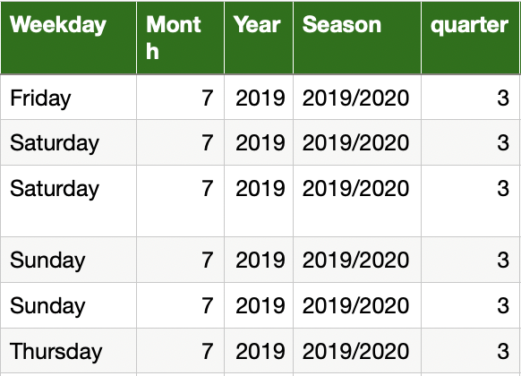
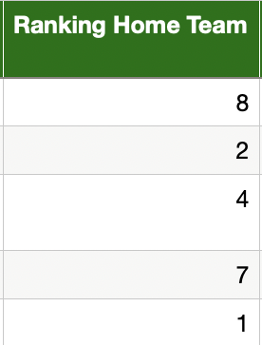
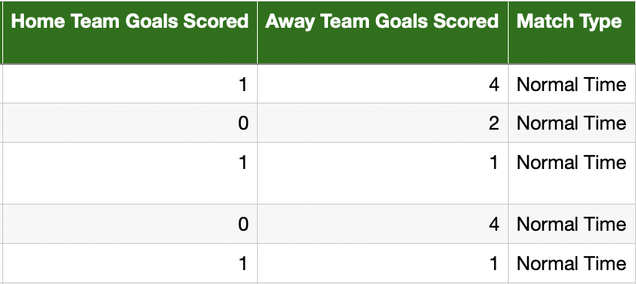
Data Cleaning
2. Data Preparation

Slide 6
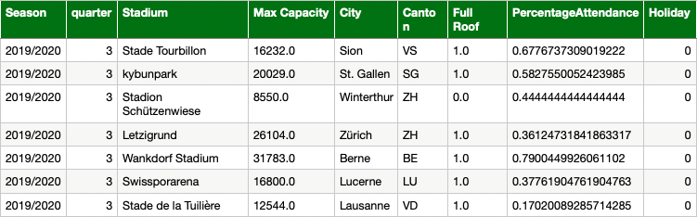
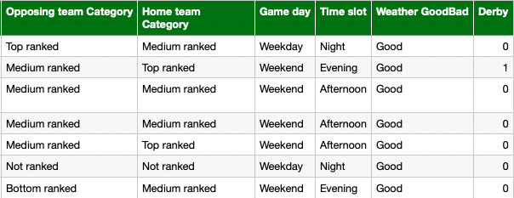
Feature Engineering
2. Data Preparation
Creating New Features
Categorization

Slide 7

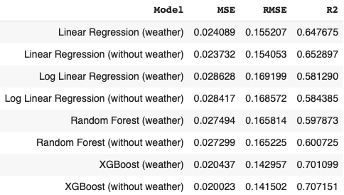
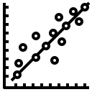


Models
3. Model Explanation
Features
Model
Home Team
Opposing Team
Linear Regression
Include Weather
Exclude Weather
Log Transformation
Competition
Matchday
Random Forest
Match Time
Match Date
14 Days
XGBoost
Linear Regression
Linear Regression performs better without Log Transformation and weather data
Tree Based Models
Random Forest performs worse than Linear Regression
XGBoost handles complex patterns effectively, achieving the best performance
Overall Evaluation
Weather did not play as big a role as previously expected
XGBoost is the overall best performing model, handling complex data most effectively
Notes:
Regarding to the model, we ran 8 different models, indeed in addition to running Linear Regression, Log linear regression, random forest and Xgboost, we also decided to run each of them with and without the weather. Why so? We thought about the app and believed that in case a client would enter a date beyond two weeks from now, the weather preditctions are not precise enough to be taken in account. But we will see that more in details in the next slides.
One of the challenges we ran into however was Not having enough data points for extreme events such as the champions league for example with only 20 rows.
According to our results, the baseline linear model actually performed better without both the log transformation and the weather data and actually performed better than the random forest.
However, as was expected it is our Xgboost model that worked best and that we therefore decided to use for our app.

Slide 8

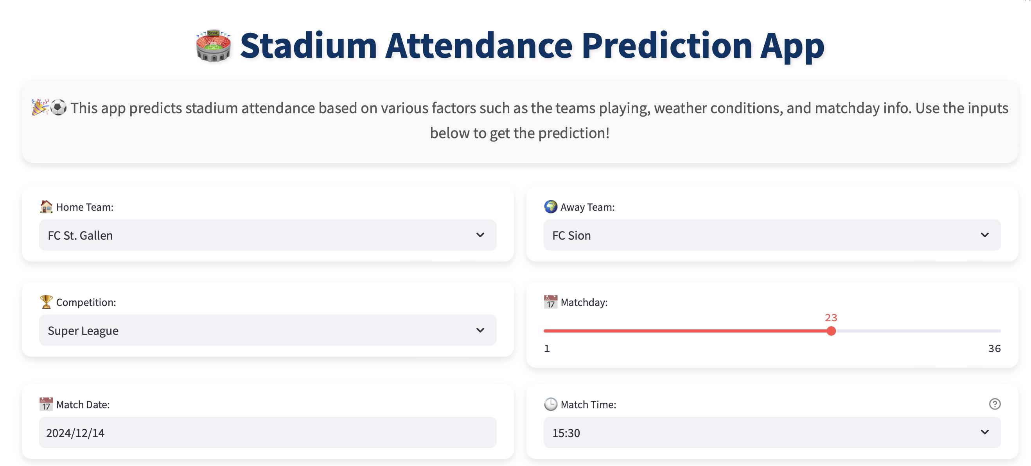


Streamlit Solution - Input
4. Web App & Use Case
Input Features
A
Select Home Team
B
Choose Competition
C
Select Matchday / Type based on Competition
D
Select Match Date & Time
Features obtained from Inputs
A
Weather (within 14 days)
B
Home / Opposing Team Ranking
C
Goals scored / Wins in the last 5 Matches
Notes:
Let’s now turn to the DATA APP
So, The user will firstly have to Select both the Home Team and away team, the competition and the match time.
It’s important to note that we intentionaly decided not to use the stadium name instead of the home team as Grosshopers and Zurich FC share the same Stadium.
The user will also have to select the Matchday and match Date. It might sound confusing if you are not a football enthusiast but the match day is a specific round in a league where all teams play their designated games for that specific round.

Slide 9
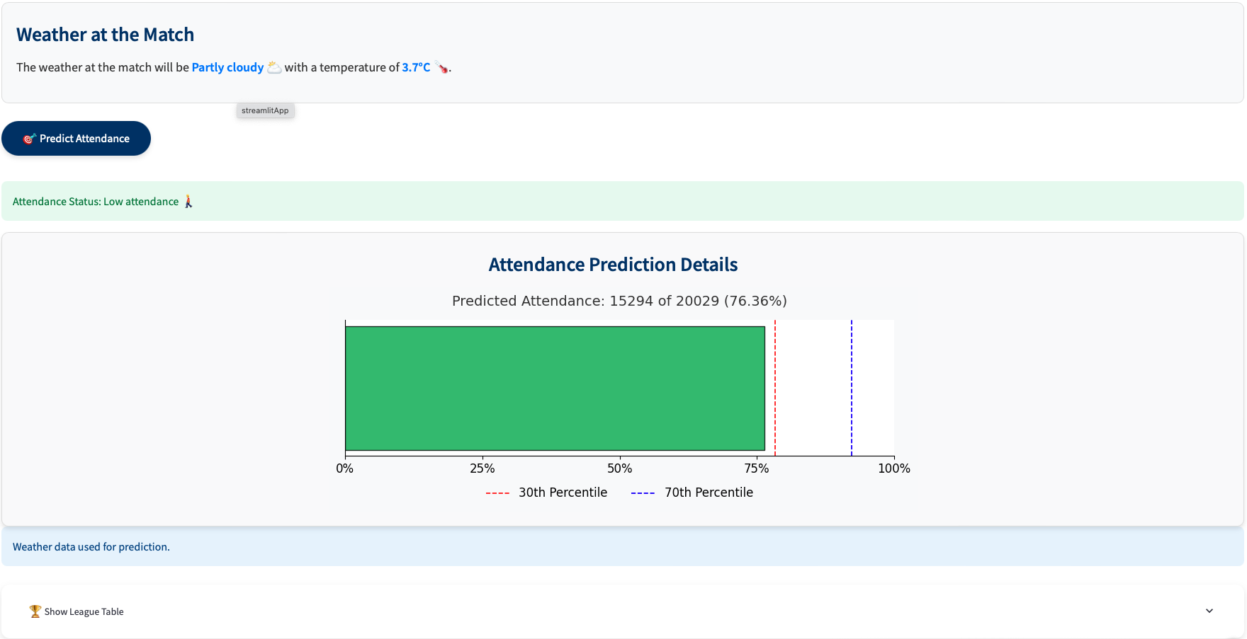



Streamlit Solution – Output & Use Case
4. Web App & Use Case
Output
A
Expected Weather at Date and Time
B
Prediction of Total and Relative Attendance
C
Comparison to avg. Attendance
Use Case
A
Improve Operational Efficiency; plan crowd management
B
Improve staff management efficiency
C
Planning for large-scale events, manage crowd flows, and improve overall visitor experience
Notes:
Thanks to those inputs the app predicts the attendance of the game by giving the absolute attendance and the relative one in percentage.
To allow for further comparison, the app also indicates the 30th and 70th percentile.
Lastly, based on the input will be provided the expected weather if the weather is within the next 14 days, the home and opposing team ranking, and the goals scored and the wins over the last five games

Slide 10
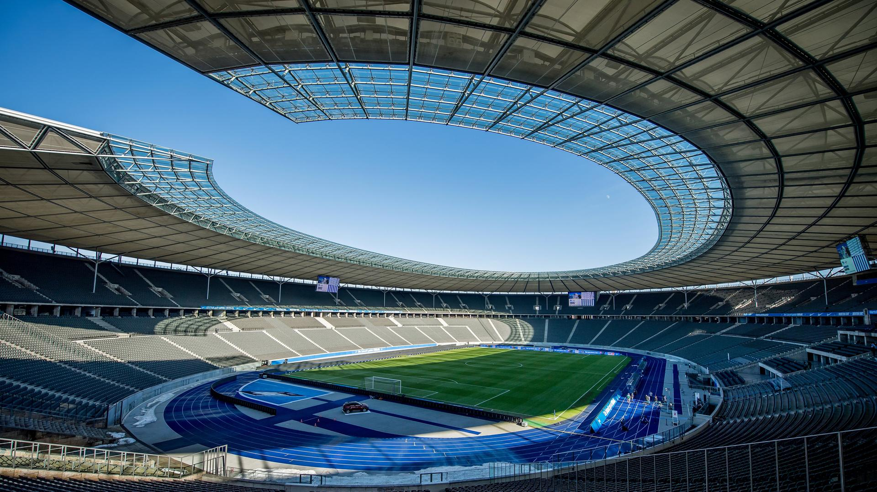

Thank you!
Victor Thijs
Tobias Blankenagel
Clément Durix
Vincent Neuhaus
22-605-737
victor.thijs@ student.unisg.ch
22-605-737
tobias.blankenagel@ student.unisg.ch
22-605-737
clementbaptiste.durix@ student.unisg.ch
22-605-737
vincent.neuhaus@ student.unisg.ch

